Slide 1
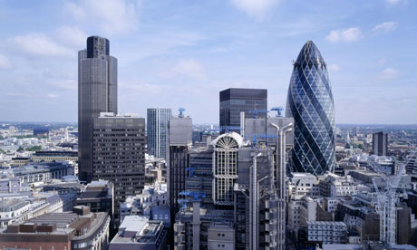


Cryptocurrencies, blockchain & the future of money
The future of money: Stablecoin cryptocurrencies
Gavin Brown talk in Manchester on Thur 28th March 2019
Gavin Brown
PhD Canididate
Keele University
Senior Lecturer
The Future Economies Research Centre
Manchester Metropolitan University
The Future of money:
Stablecoin cryptocurrencies, a critical review of premia & discounts using
principles of
arbitrage
Notes:
Introduction

Slide 2
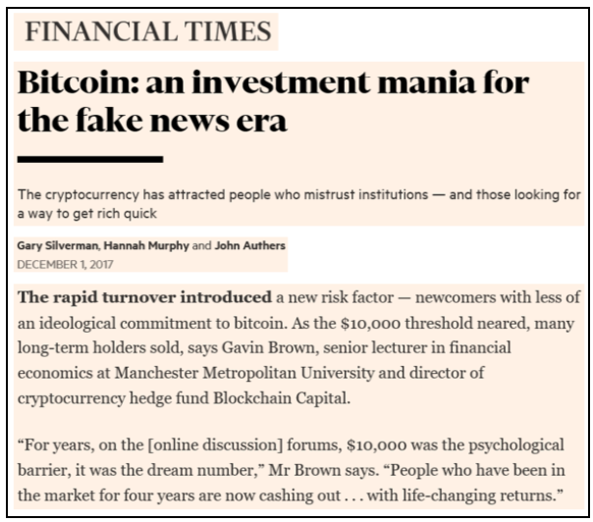
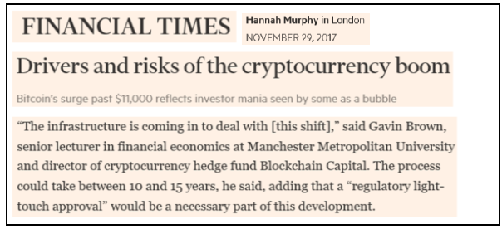
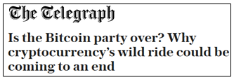
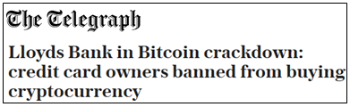
My journey
The future of money: Stablecoin cryptocurrencies
Gavin Brown talk in Manchester on Thur 28th March 2019

Slide 3
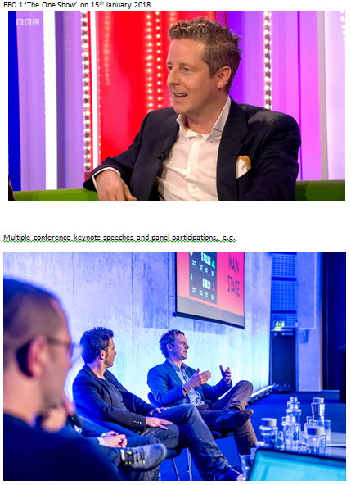

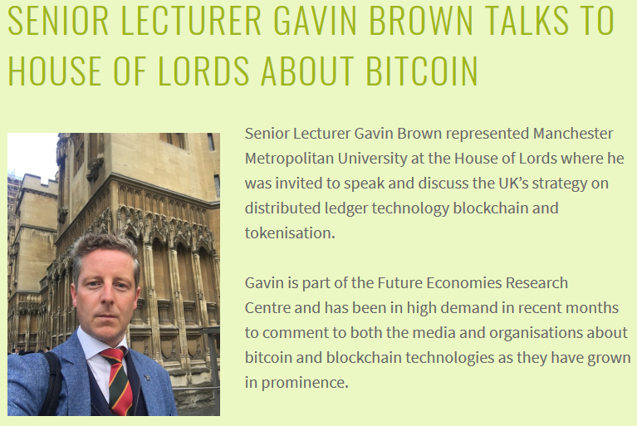
My journey continued…
The future of money: Stablecoin cryptocurrencies
Gavin Brown talk in Manchester on Thur 28th March 2019

Slide 4
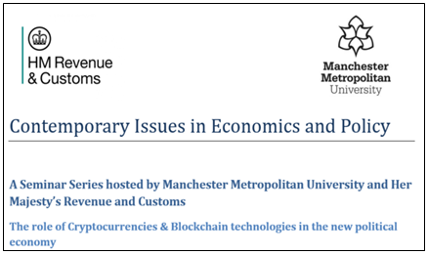







My journey continued…
The future of money: Stablecoin cryptocurrencies
Gavin Brown talk in Manchester on Thur 28th March 2019
Feedback from my talk at HMRC, H.M.Treasury & UK Government in London Jan-18
This is probably one of the most engaging and forward thinking events I have attended at HMRC.
Made a potentially complex subject easy to understand for a beginner.
Really great seminar – more please!
An excellent topic and speaker. Really engaging and thought-provoking. Good to see such a high turnout.
Good interaction between the presenter and the audience, with questions being asked as we went along rather than just at the end.
The speaker was excellent, thank you.
I found it really helpful as an introduction to what was before an opaque area of the economy, and its potential impact on taxation. Very good to get the perspective of someone who works in the field both as entrepreneur and academic.
The presenter was great, really engaging.
I just wanted to say that the presenter was amazing. He was very knowledgeable, energetic and able to maintain the interest high throughout the event. I really thoroughly enjoyed the seminar.
I thought this was an excellent presentation, and easy to understand from a basic level, which was very helpful. It was really informative and very enjoyable.
Overall it was a very engaging talk and did not seem like 90 minutes.
Great event, excellent presenter and very topical.
“This is probably one of the most engaging and forward thinking events I have attended at HMRC”.

Slide 5
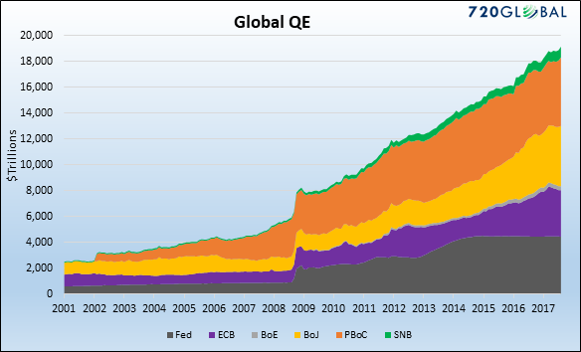
A solution to address the root problem – money creation
The future of money: Stablecoin cryptocurrencies
Gavin Brown talk in Manchester on Thur 28th March 2019
Source: 720Global (2017)
Notes:
Q. Why do crisis matter?
Because as they become more impactful and frequent the response of central banks and government changes the value of our fiat currency.
Quantitative easing – not the printing of money but the repurchasing of state issued securities.
This expands the money supply, decreases real interest rates and therefore encourages investment to restart the economy.
It also devalues the fiat currency all other things being equal.
The outcome is that your fiat currency (wealth) is with less through no fault of your own at the individual level.

Slide 6
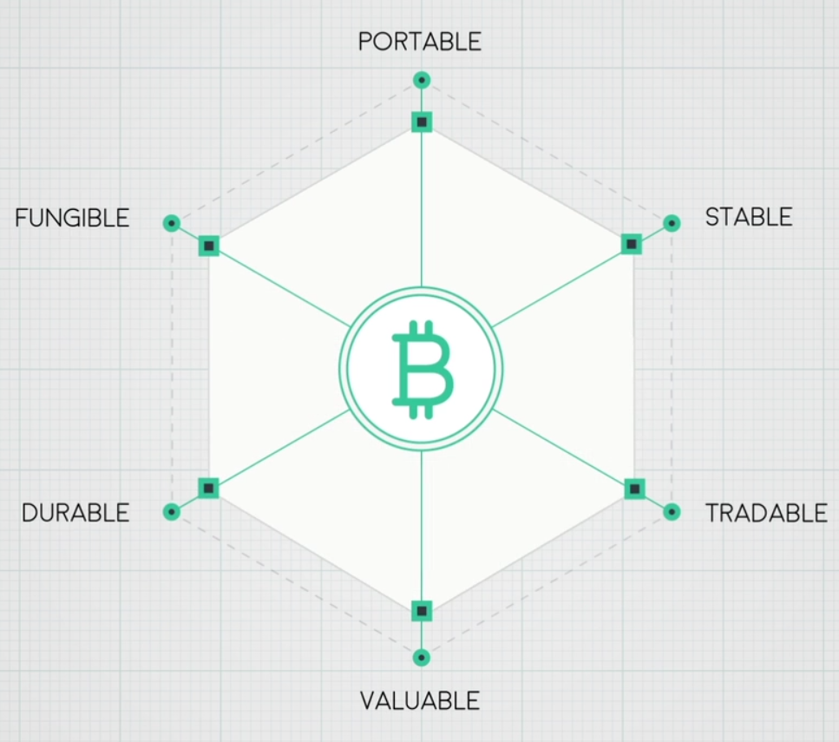
Bitcoin as a fiat money replacement?
The future of money: Stablecoin cryptocurrencies
Gavin Brown talk in Manchester on Thur 28th March 2019

Slide 7
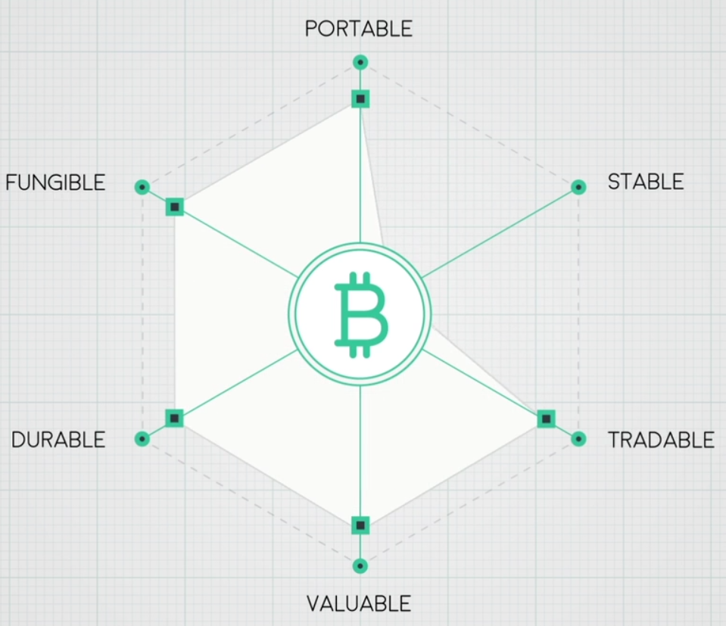
Bitcoin as a fiat money replacement continued…
The future of money: Stablecoin cryptocurrencies
Gavin Brown talk in Manchester on Thur 28th March 2019

Slide 8
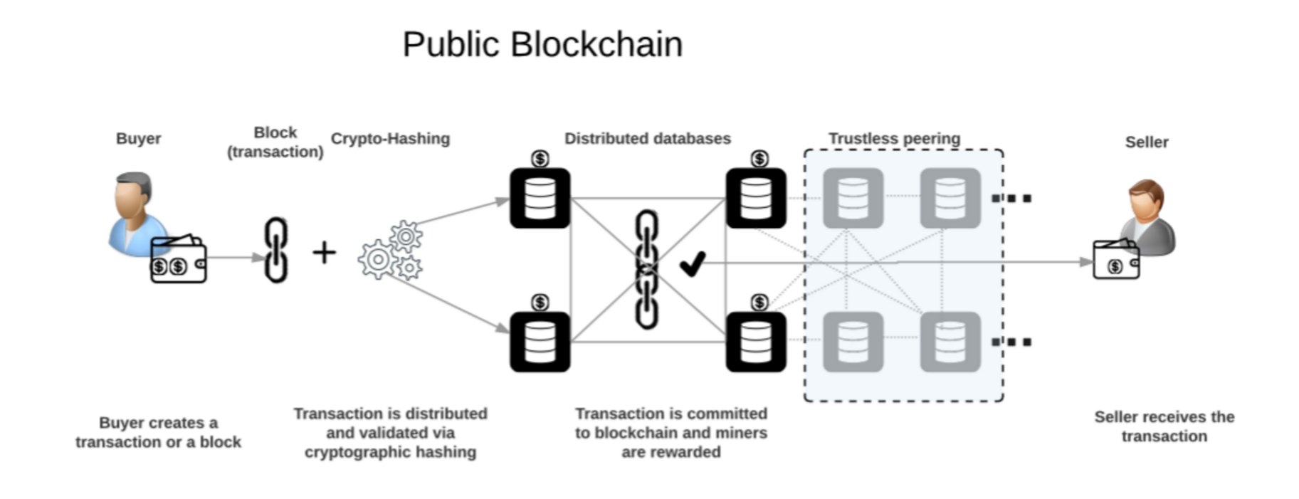
(i) A public blockchain
The future of money: Stablecoin cryptocurrencies
Gavin Brown talk in Manchester on Thur 28th March 2019

Slide 9
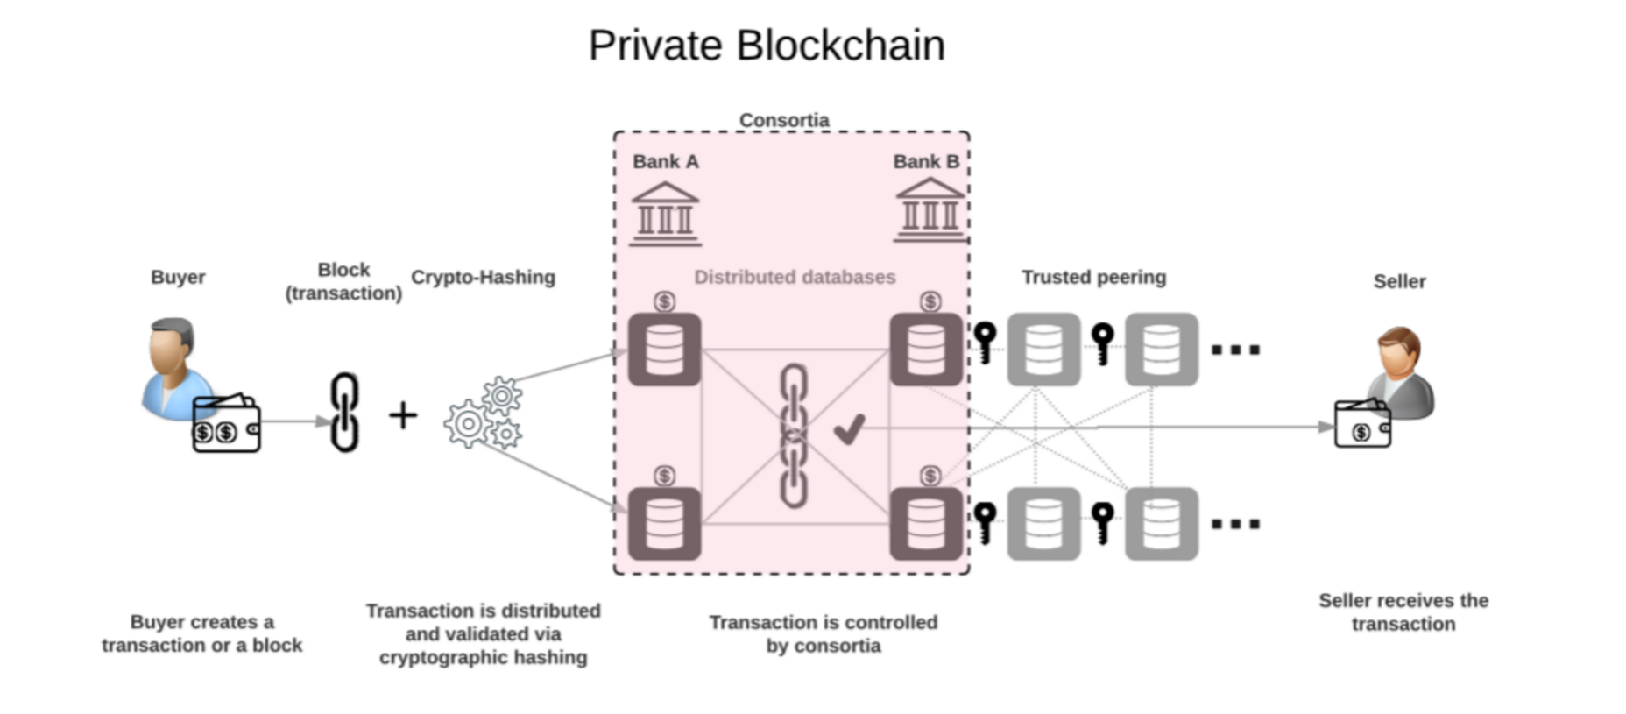
(ii) A private blockchain
The future of money: Stablecoin cryptocurrencies
Gavin Brown talk in Manchester on Thur 28th March 2019

Slide 10
Cryptocurrencies in a global context
The future of money: Stablecoin cryptocurrencies
Gavin Brown talk in Manchester on Thur 28th March 2019
Q1 2018 BTC multiples | US$ | vs BTC
All money | 89.6 T | 298.7
Stock markets | 66.8 T | 222.7
Physical money | 31.0 T | 103.3
Gold market cap | 8.2 T | 27.3
USD in circulation | 1.5 T | 5.0
All cryptocurrencies | 0.8 T | 2.7
Apple | 0.7 T | 2.3
Amazon | 0.4 T | 1.3
Bitcoin (Q1 BTC price multiples) Mkt cap now = US$ 0.068 T) | 0.3 T | 1.0
Source: Bloomberg (2018)
Notes:
BTC and cryptocurrencies do not represent a material risk to global markets.
This is echoed by the BoE statements.
However, it is still large enough to pose a headache for regulators, governments, tax authorities and central banks.
It was the second agenda item after ‘Russia’ for the Q1 meeting of the G20 this year.
The only way Bitcoin goes away is with either of the following events;
Global society cease to associate value with it.
A >50% attack on the underlying blockchain to render the currency useless. Note, ref to quantum computing.
Simultaneously turn-off the electricity / internet globally.

Slide 11
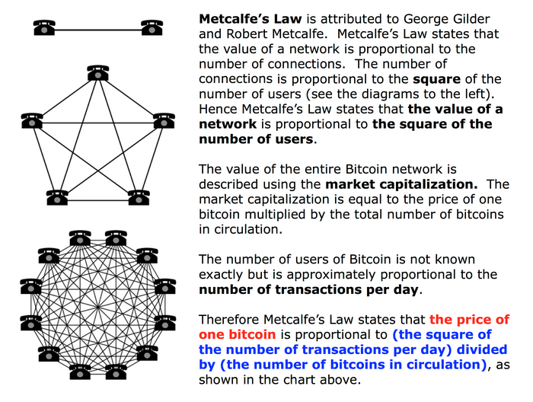
So, how do we value this new asset class?
The future of money: Stablecoin cryptocurrencies
Gavin Brown talk in Manchester on Thur 28th March 2019

Slide 12
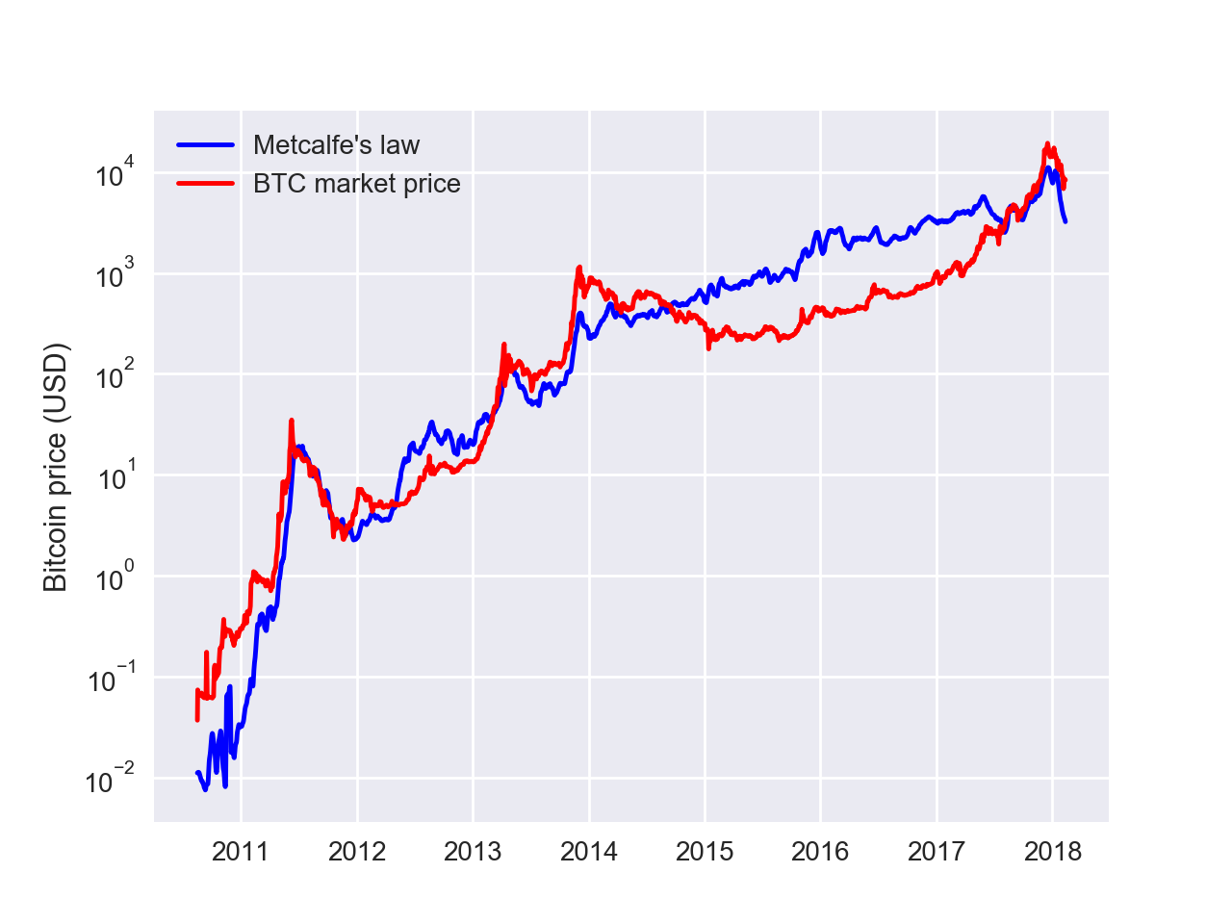
Metcalfe’s Law applied to Bitcoin
The future of money: Stablecoin cryptocurrencies
Gavin Brown talk in Manchester on Thur 28th March 2019

Slide 13
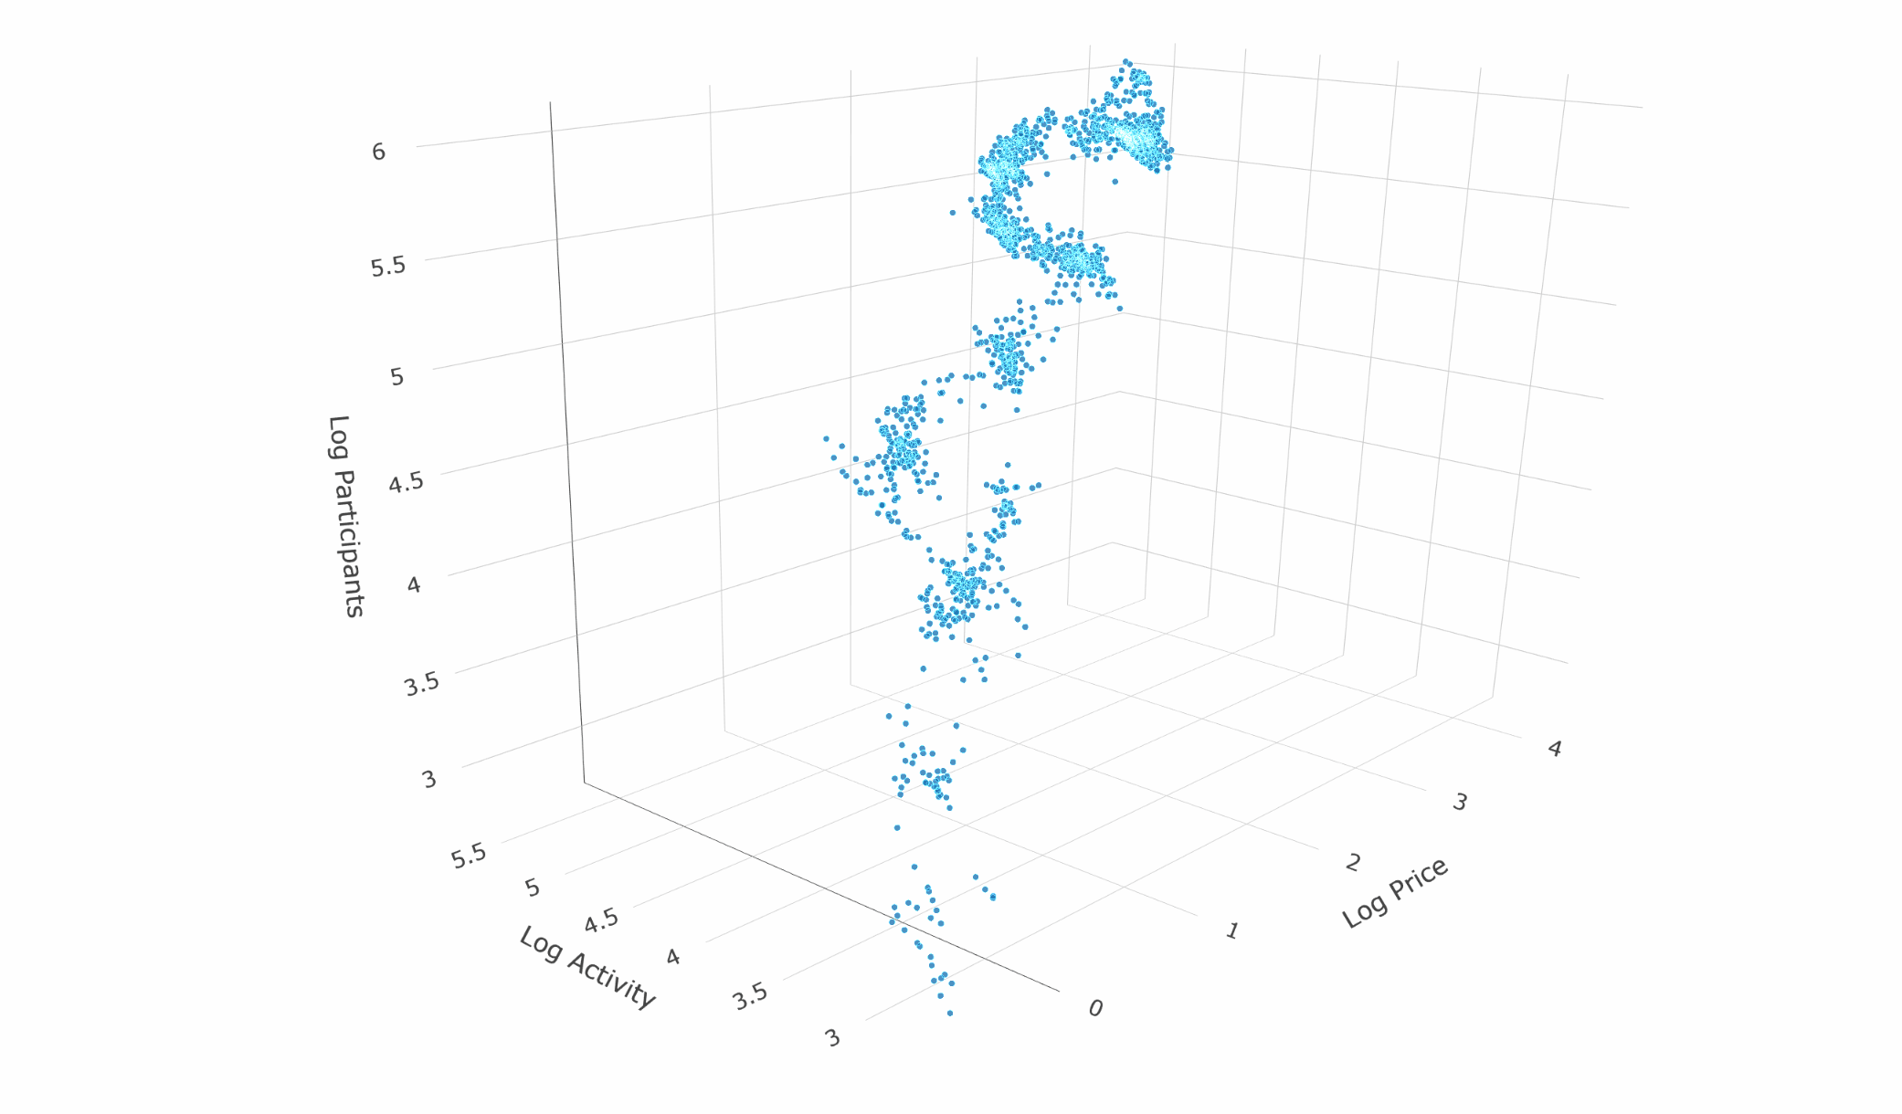
Continued,…
The future of money: Stablecoin cryptocurrencies
Gavin Brown talk in Manchester on Thur 28th March 2019

Slide 14
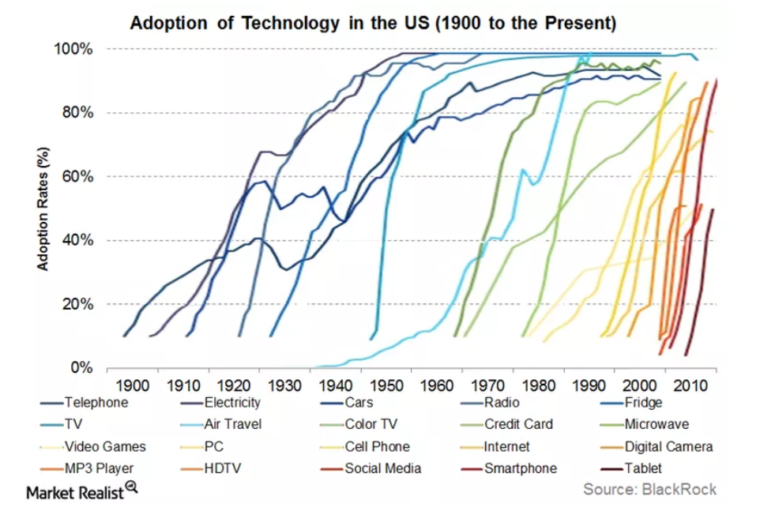
If cryptocurrencies & tokens are so good where is the mass adoption?
The future of money: Stablecoin cryptocurrencies
Gavin Brown talk in Manchester on Thur 28th March 2019
Notes:
Q. If cryptocurrencies have so many great benefits then why are we a decade since their introduction and still they are only at best on the fringes of our economy.
A. Regulators prevent institutional money migrating from the old monetary system (fiat) to the new monetary system (crypto).

Slide 15
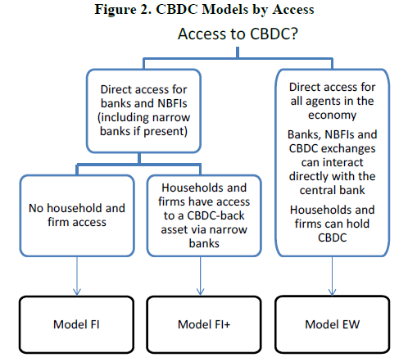
A potential route forward? – Central Bank Digital Currencies (CBDC). 3 models by The BoE
The future of money: Stablecoin cryptocurrencies
Gavin Brown talk in Manchester on Thur 28th March 2019
Source: Staff Working Paper No. 725 By Michael Kumhof and Clare Noone, Bank of England, May 2018
Notes:
Despite the efforts of the existing system to frustrate adoption central banks, including The BoE, are attempting to get ahead of what is a direct threat to their ability to control the supply of money. Competing models of CBDC possible hybrid solutions.

Slide 16
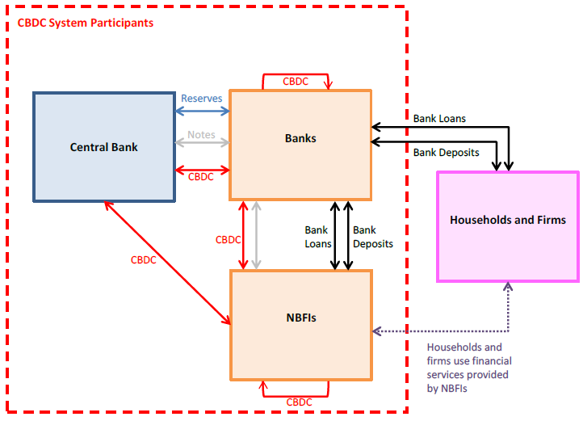
E.g. Model F.I. map proposed by The BoE (2018)
The future of money: Stablecoin cryptocurrencies
Gavin Brown talk in Manchester on Thur 28th March 2019
Source: Staff Working Paper No. 725 By Michael Kumhof and Clare Noone, Bank of England, May 2018
Notes:
The mechanics of how the new and the old banking systems would fuse.
See working paper here;
https://www.bankofengland.co.uk/working-paper/2018/central-bank-digital-currencies---design-principles-and-balance-sheet-implications

Slide 17
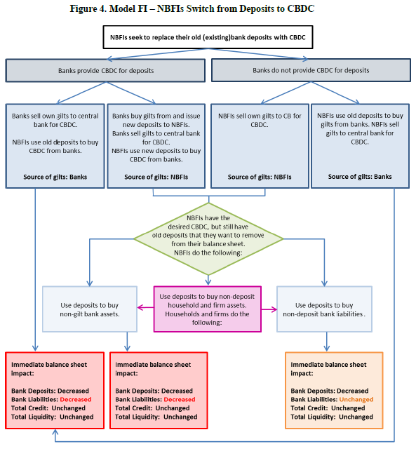
E.g. Model F.I. cont.…
The future of money: Stablecoin cryptocurrencies
Gavin Brown talk in Manchester on Thur 28th March 2019
Source: Staff Working Paper No. 725 By Michael Kumhof and Clare Noone, Bank of England, May 2018
Notes:
Balance sheet impact of CDBC adoption

Slide 18

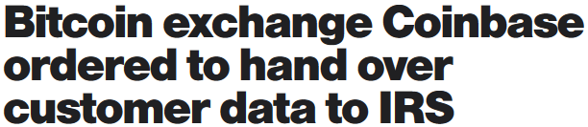

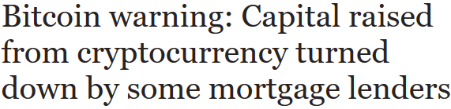
Tax challenges, policy responses & future scenarios
The future of money: Stablecoin cryptocurrencies
Gavin Brown talk in Manchester on Thur 28th March 2019
Tax challenges
Cryptocurrencies can be both 100% transparent or 100% ‘dark’ (anonymous) depending upon the wishes of the individual, e.g. in 2015 only 802 US citizens declared a cryptocurrency capital gain. AML and KYC regulation impacted.
Visible tax base reduces
Potential for the UK tax gap to widen
Some cryptocurrencies are designed to be cryptographically dark, e.g. Monero
Policy response
HMRC Brief 9 (2014) Bitcoin & other cryptocurrencies
Possible future scenarios
Cryptocurrencies die
Fiat currencies die
Fiat & cryptocurrencies co-exist
Corporates issue their own ICO, e.g. FacebookCoin, TwitterCoin and AmazonCoin, etc.
Notes:
Going forward a coexistence of fiat and cryptocurrency is predicted.
The ability of MCN’s to issue their own coins is also the next logical step.
Individuals do not spend their money directly with the state,…only indirectly through taxation.
Direct spending is usually made to companies with whom goods are purchased.
MCN’s own coins would allow them to wrestle control of the money supply away from the nation state to themselves so they can extract value and nudge their consumers more fully.

Slide 19


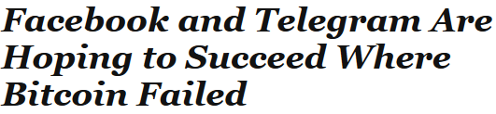
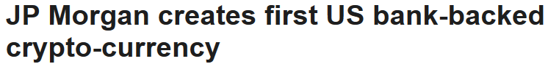
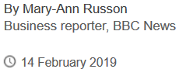
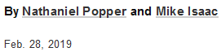

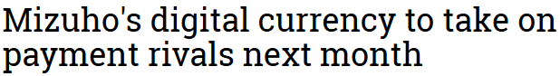
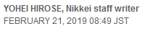
Next generation cryptocurrency – stablecoins
The future of money: Stablecoin cryptocurrencies
Gavin Brown talk in Manchester on Thur 28th March 2019

Slide 20
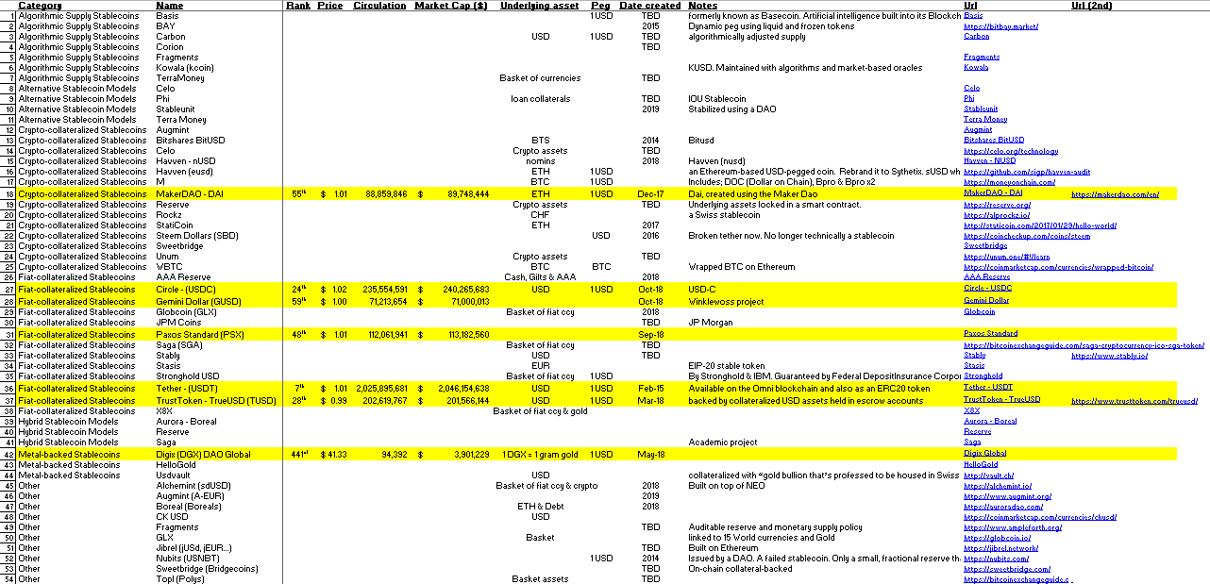
Stablecoins ecosystem
The future of money: Stablecoin cryptocurrencies
Gavin Brown talk in Manchester on Thur 28th March 2019

Slide 21
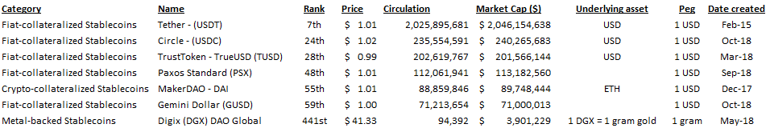
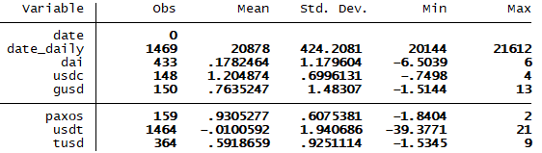
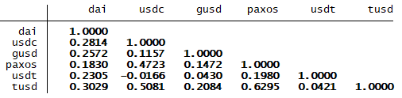
Leading stablecoins for investigation & descriptive statistics
The future of money: Stablecoin cryptocurrencies
Gavin Brown talk in Manchester on Thur 28th March 2019

Slide 22
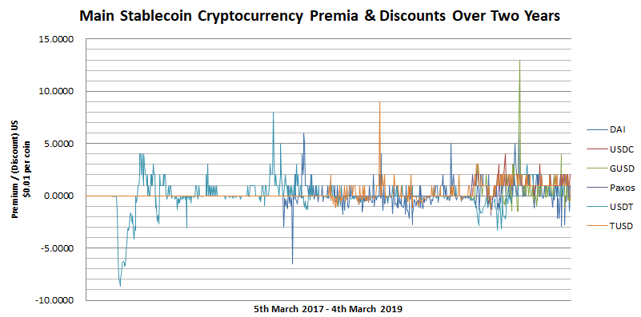
6 mainstream stablecoins
The future of money: Stablecoin cryptocurrencies
Gavin Brown talk in Manchester on Thur 28th March 2019

Slide 23
6 mainstream stablecoins box plots
The future of money: Stablecoin cryptocurrencies
Gavin Brown talk in Manchester on Thur 28th March 2019

Slide 24
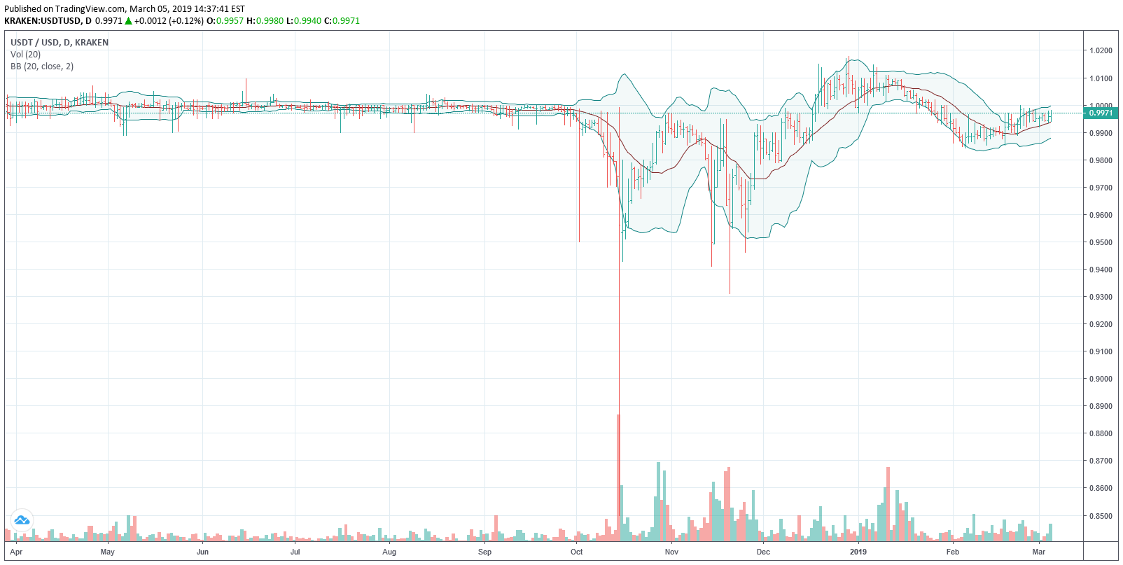
Tether (USDT) over the previous 12 months
The future of money: Stablecoin cryptocurrencies
Gavin Brown talk in Manchester on Thur 28th March 2019

Slide 25
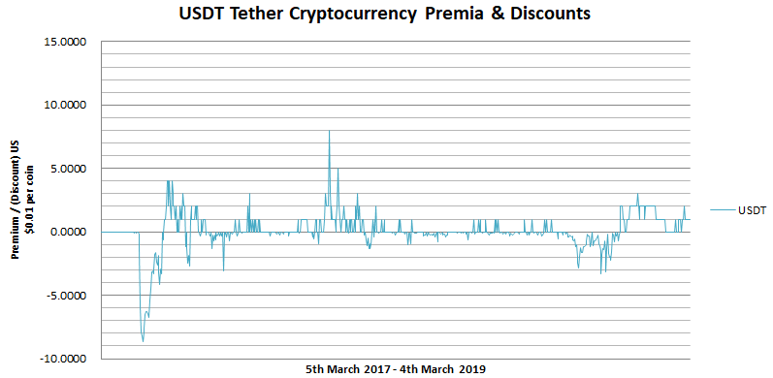
Tether (USDT)
The future of money: Stablecoin cryptocurrencies
Gavin Brown talk in Manchester on Thur 28th March 2019

Slide 26
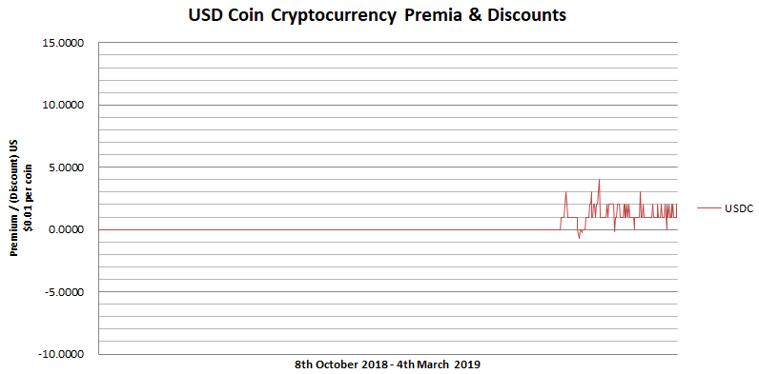
Circle (USDC)
The future of money: Stablecoin cryptocurrencies
Gavin Brown talk in Manchester on Thur 28th March 2019

Slide 27
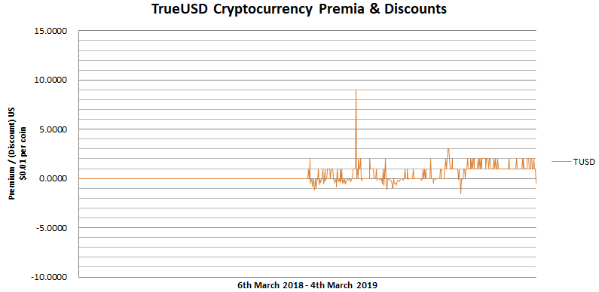
True USD (TUSD)
The future of money: Stablecoin cryptocurrencies
Gavin Brown talk in Manchester on Thur 28th March 2019

Slide 28
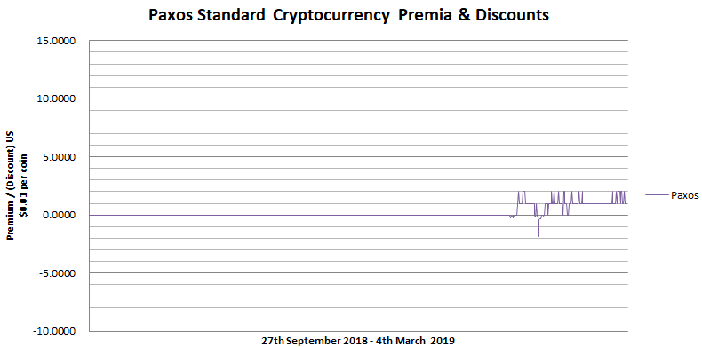
Paxos (PSX)
The future of money: Stablecoin cryptocurrencies
Gavin Brown talk in Manchester on Thur 28th March 2019

Slide 29
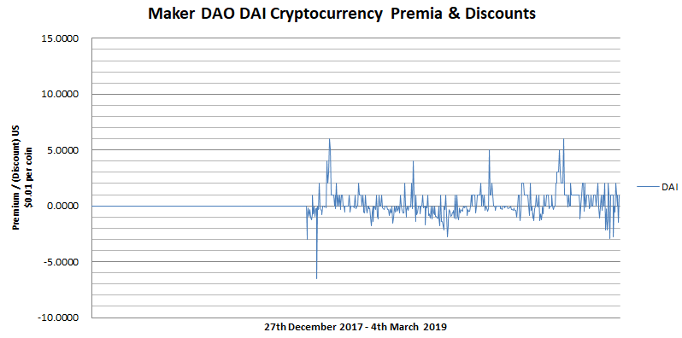
MAKER DAO (DAI)
The future of money: Stablecoin cryptocurrencies
Gavin Brown talk in Manchester on Thur 28th March 2019

Slide 30
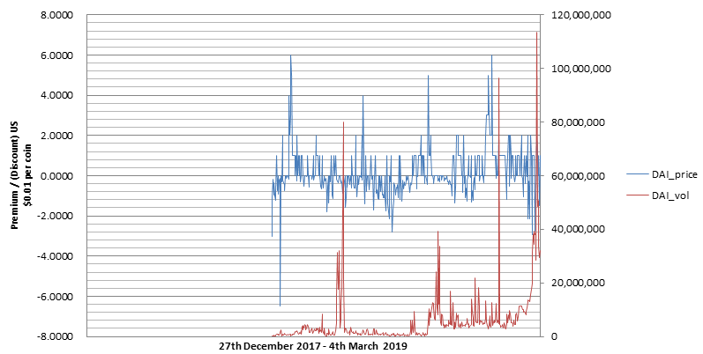
DAI incorporating volume – ∆ price uncorrelated to ∆ volume (ρ = +0.07)
The future of money: Stablecoin cryptocurrencies
Gavin Brown talk in Manchester on Thur 28th March 2019

Slide 31
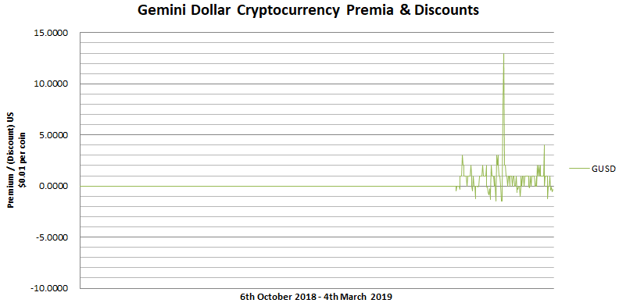
Gemini Dollar (GUSD)
The future of money: Stablecoin cryptocurrencies
Gavin Brown talk in Manchester on Thur 28th March 2019

Slide 32
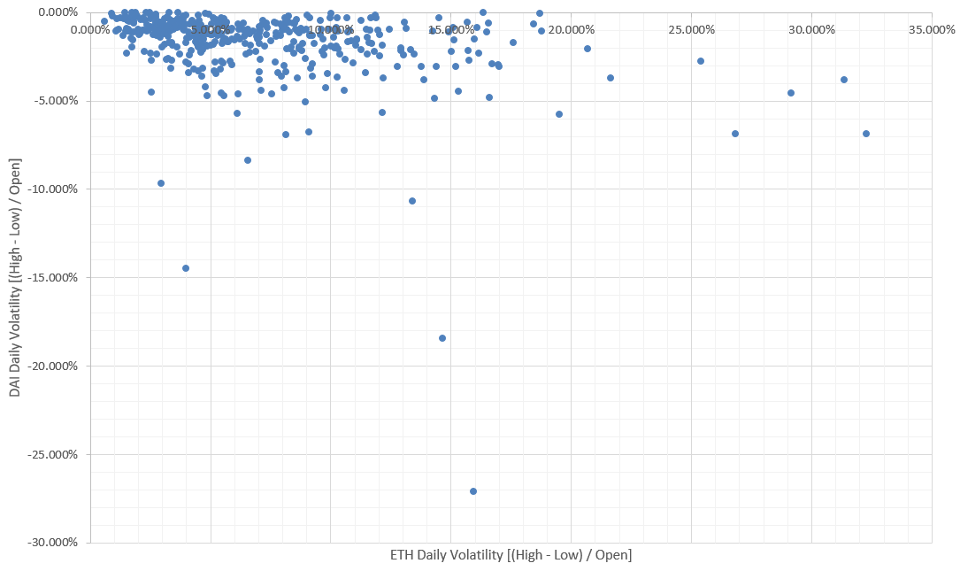
DAI daily volatility dampening (Dec 2017 – Mar 2019)
The future of money: Stablecoin cryptocurrencies
Gavin Brown talk in Manchester on Thur 28th March 2019

Slide 33
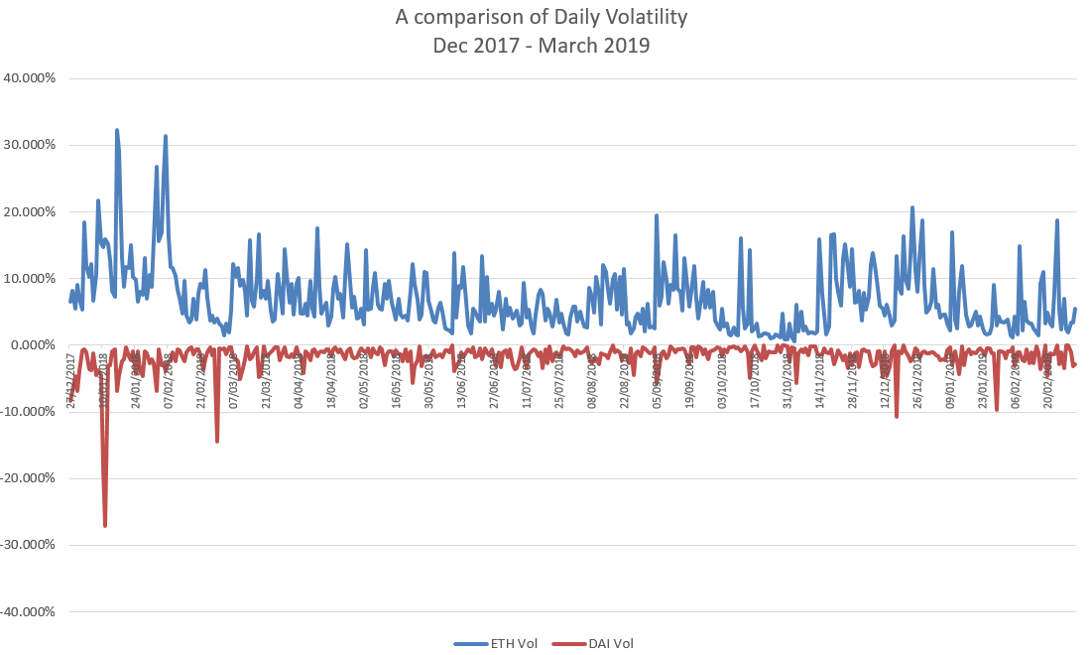
Volatility dampening cont…
The future of money: Stablecoin cryptocurrencies
Gavin Brown talk in Manchester on Thur 28th March 2019

Slide 34
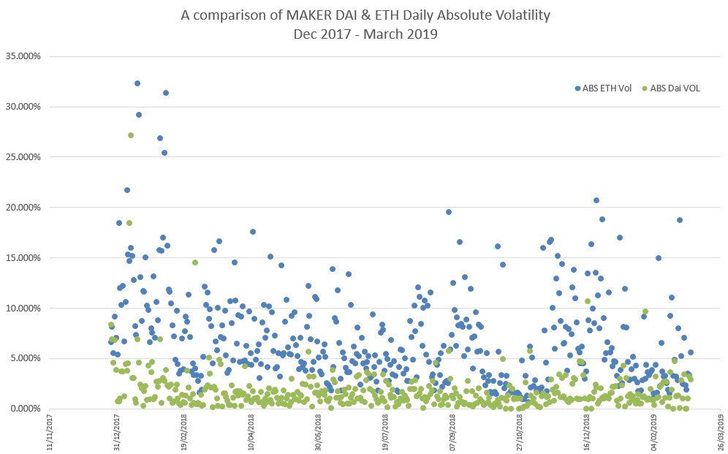
Volatility dampening continued
The future of money: Stablecoin cryptocurrencies
Gavin Brown talk in Manchester on Thur 28th March 2019

Slide 35
Questions
The future of money: Stablecoin cryptocurrencies
Gavin Brown talk in Manchester on Thur 28th March 2019
Which variables can explain the deviation of stablecoin prices from their peg?
Can option pricing theory be used to evaluate the volatility spread between DAI and ETH? E.g. reverse barrier option
Is the Maker DAO leverage vehicle stable to scale?
What are the characteristics of underlying collateral assets that can be securitised by Maker beyond that of Ethereum?
What is the utility premium of a functioning stable coin relative to its underlying fiat currency?

Slide 36


Next steps…academic / corporate / conference keynote talks
The future of money: Stablecoin cryptocurrencies
Gavin Brown talk in Manchester on Thur 28th March 2019

Slide 37

Any questions?
The future of money: Stablecoin cryptocurrencies
Gavin Brown talk in Manchester on Thur 28th March 2019
Notes:
End

